Slide 1
CS 152 Computer Architecture and Engineering CS252 Graduate Computer Architecture Lecture 4 – Pipelining Part II
Krste Asanovic
Electrical Engineering and Computer Sciences
University of California at Berkeley
http://www.eecs.berkeley.edu/~krste
http://inst.eecs.berkeley.edu/~cs152

Slide 2
Last Time in Lecture 3
Iron law of performance:
time/program = insts/program * cycles/inst * time/cycle
Classic 5-stage RISC pipeline
Structural, data, and control hazards
Structural hazards handled with interlock or more hardware
Data hazards include RAW, WAR, WAW
Handle data hazards with interlock, bypass, or speculation
Control hazards (branches, interrupts) most difficult as change which is next instruction
Branch prediction commonly used
Precise traps: stop cleanly on one instruction, all previous instructions completed, no following instructions have changed architectural state

Slide 3
Asynchronous Interrupts
An I/O device requests attention by asserting one of the prioritized interrupt request lines
When the processor decides to process the interrupt
It stops the current program at instruction I_{i} , completing all the instructions up to I_{i-1} (precise interrupt)
It saves the PC of instruction I_{i} in a special register (EPC)
EPC = Exception Program Counter, but also used for traps cause by interrupts
Saves reason for interrupt in special Cause register, so handler can determine what to do
Disables interrupts and transfers control to a designated interrupt handler running in supervisor mode

Slide 4
Trap: altering the normal flow of control
I_{i-1}
HI₁
trap
handler
program
I_{i}
HI₂
I_{i+1}
HI_{n}
An external or internal event that needs to be processed by another (system) program. The event is usually unexpected or rare from program’s point of view.

Slide 5
Trap Handler
Saves EPC before enabling interrupts to allow nested interrupts ⇒
need an instruction to move EPC into GPRs
need a way to mask further interrupts at least until EPC can be saved
Needs to read the Cause register that indicates the reason for the trap
Uses a special indirect jump instruction ERET (return-from-environment) which
enables interrupts
restores the processor to the user mode
restores hardware status and control state
sets PC to the EPC value, and resumes execution

Slide 6
Synchronous Trap
A synchronous trap is caused by an exception on a particular instruction
In general, the instruction cannot be completed and needs to be restarted after the exception has been handled
May require undoing the effect of one or more partially executed instructions in microarchitecture
In the case of a system call trap, the instruction is considered to have been completed
In RISC-V, a special ECALL instruction causes a trap into a higher-privilege mode

Slide 7
Exception Handling 5-Stage Pipeline
PC
Inst. Mem
D
Decode
E
M
Data Mem
W
+
PC address Exception
Illegal Opcode
Overflow
Data address Exceptions
Asynchronous Interrupts
How to handle multiple simultaneous exceptions in different pipeline stages?
How and where to handle external asynchronous interrupts?

Slide 8
Exception Handling 5-Stage Pipeline
Commit Point
PC
Inst. Mem
D
Decode
E
M
Data Mem
W
+
Illegal Opcode
Overflow
Data address Exceptions
PC address Exception
Exc
D
Exc
E
Exc
M
Cause
PC
D
PC
E
PC
M
EPC
Select Handler PC
Kill F Stage
Kill D Stage
Kill E Stage
Asynchronous
Interrupts
Kill Writeback

Slide 9
Exception Handling 5-Stage Pipeline
Hold exception flags in pipeline until commit point (M stage)
Exceptions in earlier pipe stages override later exceptions for a given instruction
Inject external interrupts at commit point (override others)
If trap at commit: update Cause and EPC registers, kill all stages, inject handler PC into fetch stage

Slide 10
Speculating on Exceptions
Prediction mechanism
Exceptions are rare, so simply predicting no exceptions is very accurate!
Check prediction mechanism
Exceptions detected at end of instruction execution pipeline, special hardware for various exception types
Recovery mechanism
Only write architectural state at commit point, so can throw away partially executed instructions after exception
Launch exception handler after flushing pipeline
Bypassing allows use of uncommitted instruction results by following instructions

Slide 11
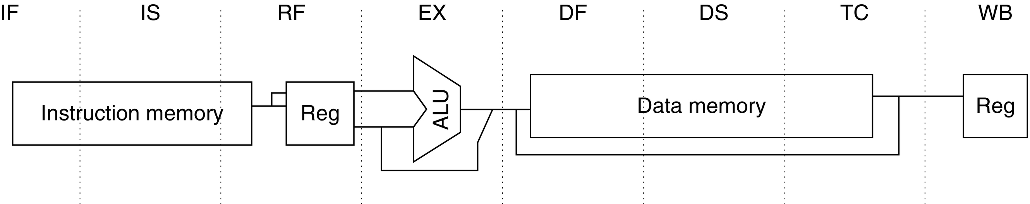
Deeper Pipelines: MIPS R4000
Commit Point
Direct-mapped I$ allows use of instruction before tag check complete
Figure C.36 The eight-stage pipeline structure of the R4000 uses pipelined instruction and data caches. The pipe stages are labeled and their detailed function is described in the text. The vertical dashed lines represent the stage boundaries as well as the location of pipeline latches. The instruction is actually available at the end of IS, but the tag check is done in RF, while the registers are fetched. Thus, we show the instruction memory as operating through RF. The TC stage is needed for data memory access, because we cannot write the data into the register until we know whether the cache access was a hit or not.
© 2018 Elsevier Inc. All rights reserved.

Slide 12
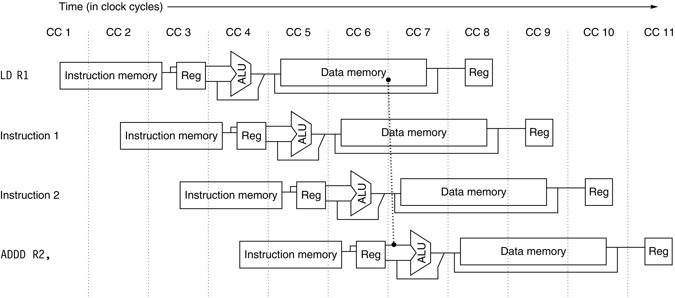
R4000 Load-Use Delay
Direct-mapped D$ allows use of data before tag check complete
Figure C.37 The structure of the R4000 integer pipeline leads to a x1 load delay. A x1 delay is possible because the data value is available at the end of DS and can be bypassed. If the tag check in TC indicates a miss, the pipeline is backed up a cycle, when the correct data are available.
© 2018 Elsevier Inc. All rights reserved.

Slide 13
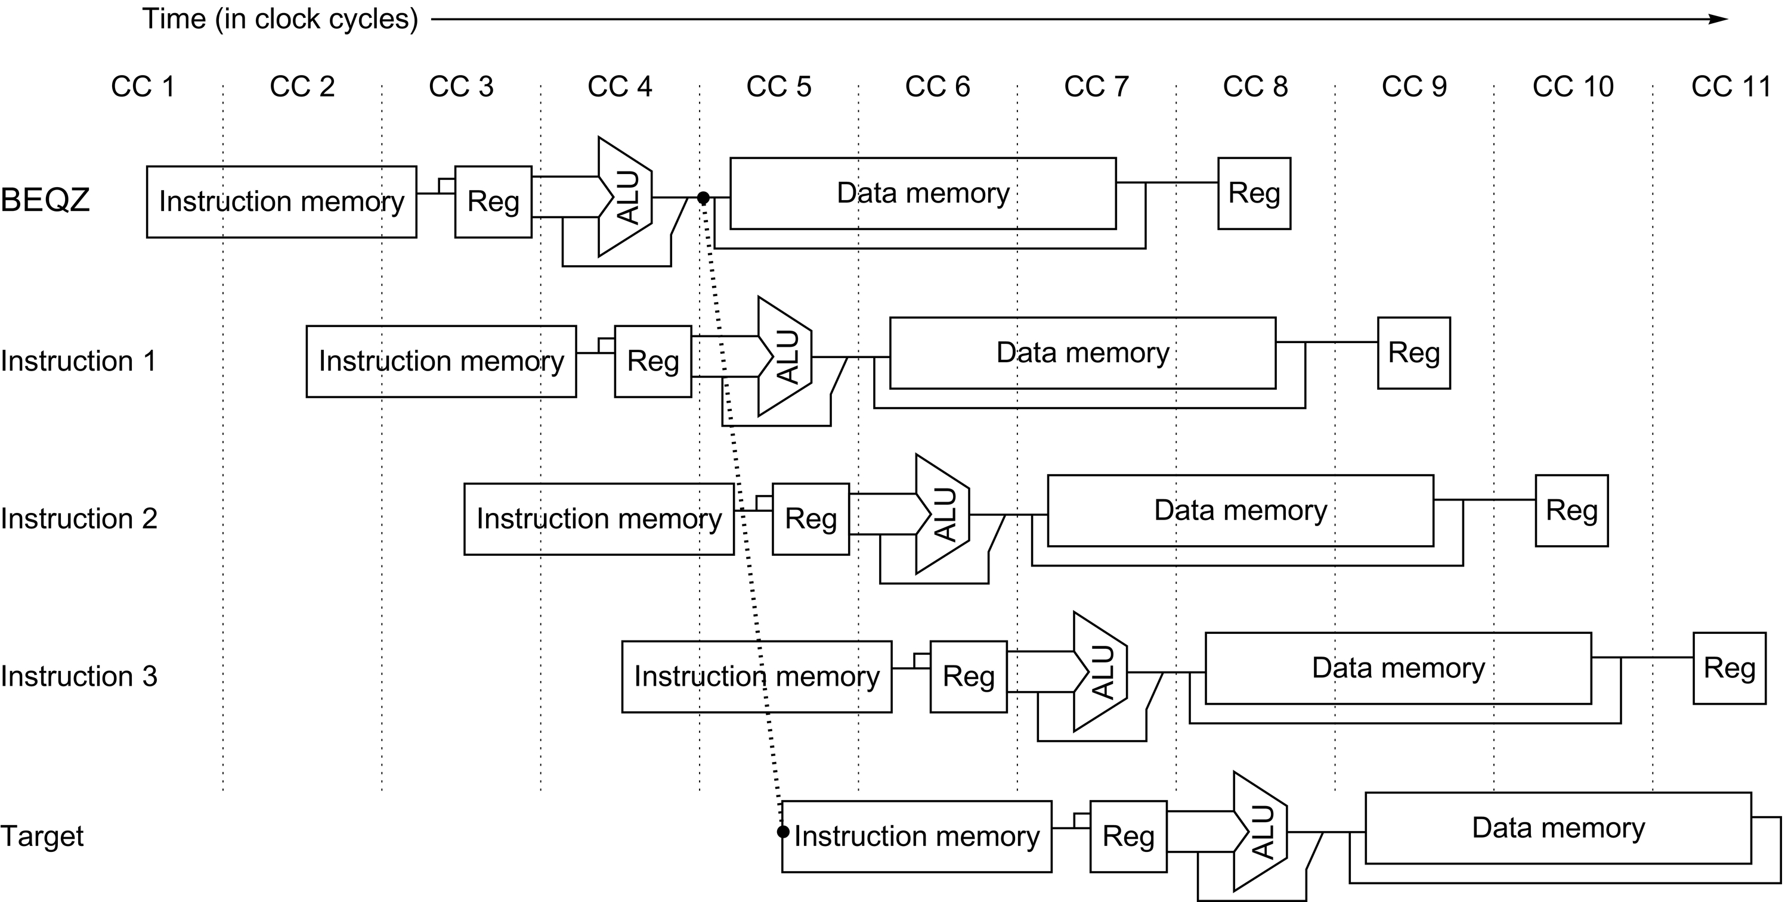
R4000 Branches
Figure C.39 The basic branch delay is three cycles, because the condition evaluation is performed during EX.
© 2018 Elsevier Inc. All rights reserved.

Slide 14
Simple vector-vector add code example
# for(i=0; i<N; i++)
# A[i] = B[i]+C[i];
loop: fld f0, 0(x2) // x2 points to B
fld f1, 0(x3) // x3 points to C
fadd.d f2, f0, f1
fsd f2, 0(x1) // x1 points to A
addi x1, x1, 8 // Bump pointer
addi x2, x2, 8 // Bump pointer
addi x3, x3, 8 // Bump pointer
bne x1, x4, loop // x4 holds end

Slide 15
Simple Pipeline Scheduling
Can reschedule code to try to reduce pipeline hazards
loop: fld f0, 0(x2) // x2 points to B
fld f1, 0(x3) // x3 points to C
addi x3, x3, 8 // Bump pointer
addi x2, x2, 8 // Bump pointer
fadd.d f2, f0, f1
addi x1, x1, 8 // Bump pointer
fsd f2, -8(x1) // x1 points to A
bne x1, x4, loop // x4 holds end
Long latency loads and floating-point operations limit parallelism within a single loop iteration

Slide 16
One way to reduce hazards: Loop Unrolling
Can unroll to expose more parallelism, reduce dynamic instruction count
loop: fld f0, 0(x2) // x2 points to B
fld f1, 0(x3) // x3 points to C
fld f10, 8(x2)
fld f11, 8(x3)
addi x3,x3,16 // Bump pointer
addi x2,x2,16 // Bump pointer
fadd.d f2, f0, f1
fadd.d f12, f10, f11
addi x1,x1,16 // Bump pointer
fsd f2, -16(x1) // x1 points to A
fsd f12, -8(x1)
bne x1, x4, loop // x4 holds end
Unrolling limited by number of architectural registers
Unrolling increases instruction cache footprint
More complex code generation for compiler, has to understand pointers
Can also software pipeline, but has similar concerns

Slide 17
Alternative Approach: Decoupling (lookahead, runahead) in µarchitecture
Can separate control and memory address operations from data computations:
loop: fld f0, 0(x2) // x2 points to B
fld f1, 0(x3) // x3 points to C
fadd.d f2, f0, f1
fsd f2, 0(x1) // x1 points to A
addi x1,x1,8 // Bump pointer
addi x2,x2,8 // Bump pointer
addi x3,x3,8 // Bump pointer
bne x1, x4, loop // x4 holds end
The control and address operations do not depend on the data computations, so can be computed early relative to the data computations, which can be delayed until later.

Slide 18
Simple Decoupled Machine
Integer Pipeline
F
D
X
M
W
{Load Data Writeback µOp}
{Compute µOp}
µOp Queue
{Store Data Read µOp}
Load Data Queue
R
X1
X2
X3
W
Floating-Point Pipeline
Check
Load Address
Load Data
Store Address Queue
Store Data Queue

Slide 19
Decoupled Execution
fld f0
Send load to memory, queue up write to f0
fld f1
Send load to memory, queue up write to f1
fadd.d
Queue up fadd.d
fsd f2
Queue up store address, wait for store data
addi x1
Bump pointer
Many writes to f0 can be in queue at same time
Check load address against queued pending store addresses
addi x2
Bump pointer
addi x3
Bump pointer
bne
Take branch
fld f0
Send load to memory, queue up write to f0
fld f1
Send load to memory, queue up write to f1
fadd.d
Queue up fadd.d
fsd f2
Queue up store address, wait for store data
…

Slide 20
Simple Decoupled Machine
Integer Pipeline
F
D
X
M
W
{Load Data Writeback µOp}
{Compute µOp}
µOp Queue
{Store Data Read µOp}
Load Data Queue
R
X1
X2
X3
W
Floating-Point Pipeline
Check
Load Address
Load Data
Store Address Queue
Store Data Queue

Slide 21
CS152 Administrivia
PS 1 due 11:59PM on Monday Feb 8
Lab 1 due 11:59PM Wed Feb 17

Slide 22
CS252 Administrivia
Project proposals due 11:59PM Wed Feb 26th
Use Krste’s office hours Tue 10-11am to get feedback on ideas
email for link
Readings discussion will be Thursdays 5-6pm
zoom link on Piazza
Questions on Piazza

Slide 23
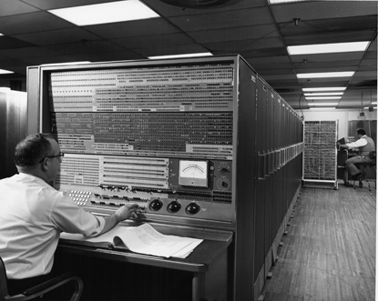
IBM 7030 “Stretch” (1954-1961)
Original goal was to use new transistor technology to give 100x performance of tube-based IBM 704.
Design based around 4 stages of “lookahead” pipelining
More than just pipelining, a simple form of decoupled execution with indexing and branch operations performed speculatively ahead of data operations
Also had a simple store buffer
© IBM
Very complex design for the time, difficult to explain to users performance of pipelined machine
When finally delivered in 1961, was benchmarked at only 30x 704 and embarrassed IBM, causing price to drop from $13.5M to $7.8M, and withdrawal after initial deliveries
But technologies lived on in later IBM computers, 360 and POWER

Slide 24
Supercomputers
Definitions of a supercomputer:
Fastest machine in world at given task
A device to turn a compute-bound problem into an I/O bound problem
Any machine costing $30M+
Any machine designed by Seymour Cray
CDC6600 (Cray, 1964) regarded as first supercomputer

Slide 25
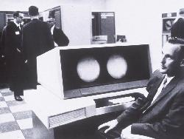

CDC 6600 Seymour Cray, 1964
A fast pipelined machine with 60-bit words
128 Kword main memory capacity, 32 banks
Ten functional units (parallel, unpipelined)
Floating Point: adder, 2 multipliers, divider
Integer: adder, 2 incrementers, ...
Hardwired control (no microcoding)
Scoreboard for dynamic scheduling of instructions
Ten Peripheral Processors for Input/Output
a fast multi-threaded 12-bit integer ALU
Very fast clock, 10 MHz (FP add in 4 clocks)
>400,000 transistors, 750 sq. ft., 5 tons, 150 kW, novel freon-based technology for cooling
Fastest machine in world for 5 years (until 7600)
over 100 sold ($7-10M each)

Slide 26
CDC 6600: A Load/Store Architecture
Separate instructions to manipulate three types of reg.
8x60-bit data registers (X)
8x18-bit address registers (A)
8x18-bit index registers (B)
All arithmetic and logic instructions are register-to-register
Only Load and Store instructions refer to memory!
Touching address registers 1 to 5 initiates a load
6 to 7 initiates a store
- very useful for vector operations
6
3
3
3
opcode i j k Ri ← Rj op Rk
6
3
3
18
opcode i j disp Ri ← M[Rj + disp]

Slide 27
CDC 6600: Datapath
Operand Regs
8 x 60-bit
operand
10 Functional
Units
result
Central
Memory
128K words,
32 banks,
1µs cycle
IR
Address Regs Index Regs
8 x 18-bit 8 x 18-bit
Inst. Stack
8 x 60-bit
operand
addr
result
addr

Slide 28
CDC6600: Vector Addition
B0 ← - n
loop: JZE B0, exit
A0 ← B0 + a0 load X0
A1 ← B0 + b0 load X1
X6 ← X0 + X1
A6 ← B0 + c0 store X6
B0 ← B0 + 1
jump loop
Ai = address register
Bi = index register
Xi = data register

Slide 29
CDC6600 ISA designed to simplify high-performance implementation
Use of three-address, register-register ALU instructions simplifies pipelined implementation
Only 3-bit register-specifier fields checked for dependencies
No implicit dependencies between inputs and outputs
Decoupling setting of address register (Ar) from retrieving value from data register (Xr) simplifies providing multiple outstanding memory accesses
Address update instruction also issues implicit memory operation
Software can schedule load of address register before use of value
Can interleave independent instructions inbetween
CDC6600 has multiple parallel unpipelined functional units
E.g., 2 separate multipliers
Follow-on machine CDC7600 used pipelined functional units
Foreshadows later RISC designs

Slide 30
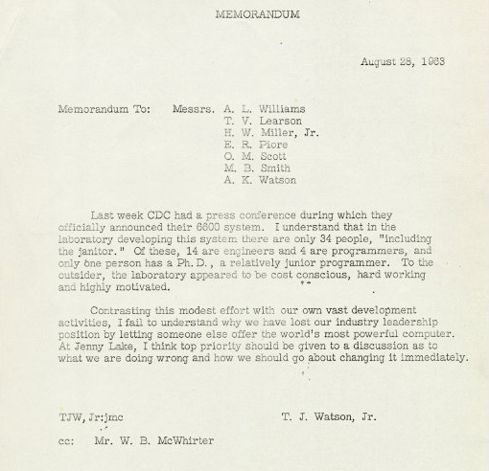
[© IBM]

Slide 31
IBM Memo on CDC6600
Thomas Watson Jr., IBM CEO, August 1963:
“Last week, Control Data ... announced the 6600 system. I understand that in the laboratory developing the system there are only 34 people including the janitor. Of these, 14 are engineers and 4 are programmers... Contrasting this modest effort with our vast development activities, I fail to understand why we have lost our industry leadership position by letting someone else offer the world's most powerful computer.”
To which Cray replied: “It seems like Mr. Watson has answered his own question.”

Slide 32
Computer Architecture Terminology
Latency (in seconds or cycles): Time taken for a single operation from start to finish (initiation to useable result)
Bandwidth (in operations/second or operations/cycle): Rate of which operations can be performed
Occupancy (in seconds or cycles): Time during which the unit is blocked on an operation (structural hazard)
Note, for a single functional unit:
Occupancy can be much less than latency (how?)
Occupancy can be greater than latency (how?)
Bandwidth can be greater than 1/latency (how?)
Bandwidth can be less than 1/latency (how?)

Slide 33
Issues in Complex Pipeline Control
Structural conflicts at the execution stage if some FPU or memory unit is not pipelined and takes more than one cycle
Structural conflicts at the write-back stage due to variable latencies of different functional units
Out-of-order write hazards due to variable latencies of different functional units
How to handle exceptions?
ALU
Mem
IF
ID
Issue
WB
Fadd
GPRs
FPRs
Fmul
Fdiv

Slide 34
CDC6600 Scoreboard
Instructions dispatched in-order to functional units provided no structural hazard or WAW
Stall on structural hazard, no functional units available
Only one pending write to any register
Instructions wait for input operands (RAW hazards) before execution
Can execute out-of-order
Instructions wait for output register to be read by preceding instructions (WAR)
Result held in functional unit until register free

Slide 35
More Complex In-Order Pipeline
PC
Inst. Mem
D
Decode
GPRs
X1
X2
Data Mem
X3
W
+
Delay writeback so all operations have same latency to W stage
Write ports never oversubscribed (one inst. in & one inst. out every cycle)
Stall pipeline on long latency operations, e.g., divides, cache misses
Handle exceptions in-order at commit point
FPRs
X1
X2
X3
W
FAdd
X2
X3
FMul
FDiv
X2
Unpipelined divider
X3
How to prevent increased writeback latency from slowing down single cycle integer operations?
Commit Point
Bypassing

Slide 36
In-Order Superscalar Pipeline
PC
Inst. Mem
D
Dual
Decode
GPRs
X1
X2
Data Mem
X3
W
2
+
FPRs
X1
X2
X3
W
FAdd
Fetch two instructions per cycle; issue both simultaneously if one is integer/memory and other is floating point
Inexpensive way of increasing throughput, examples include Alpha 21064 (1992) & MIPS R5000 series (1996)
Same idea can be extended to wider issue by duplicating functional units (e.g. 4-issue UltraSPARC & Alpha 21164) but regfile ports and bypassing costs grow quickly
X2
X3
FMul
FDiv
X2
Unpipelined divider
X3
Commit Point

Slide 37
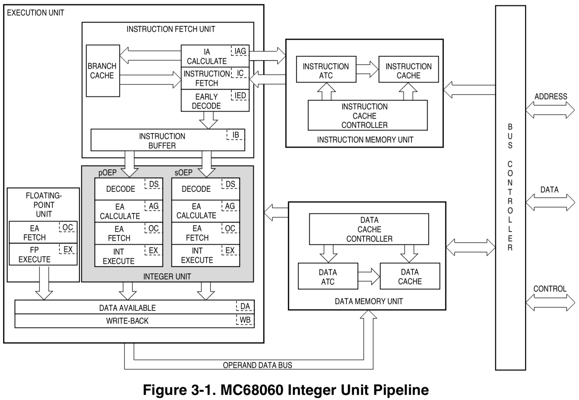
In-Order Pipeline with two ALU stages
Address calculate before memory access
Integer ALU after memory access
[ © Motorola 1994 ]

Slide 38
MC68060 Dynamic ALU Scheduling
Using RISC-V style assembly code for MC68060
EA
MEM
ALU
add x1,x1,24(x2)
x2+24
x1+M[x2+24]
EA
MEM
ALU
add x3,x1,x6
x1+x6
EA
MEM
ALU
addi x5,x2,12
x2+12
Not a real RISC-V instruction!
EA
MEM
ALU
lw x4, 16(x5)
x5+16
EA
MEM
ALU
lw x8, 16(x3)
x3+16
Common trick used in modern in-order RISC pipeline designs, even without reg-mem operations

Slide 39
Acknowledgements
This course is partly inspired by previous MIT 6.823 and Berkeley CS252 computer architecture courses created by my collaborators and colleagues:
Arvind (MIT)
Joel Emer (Intel/MIT)
James Hoe (CMU)
John Kubiatowicz (UCB)
David Patterson (UCB)

